Slide 1

CSE3151
Computer Networks
(Session 2018-19)
Dr. Asif Zaman
Associate Professor, CSE, RU

Slide 2
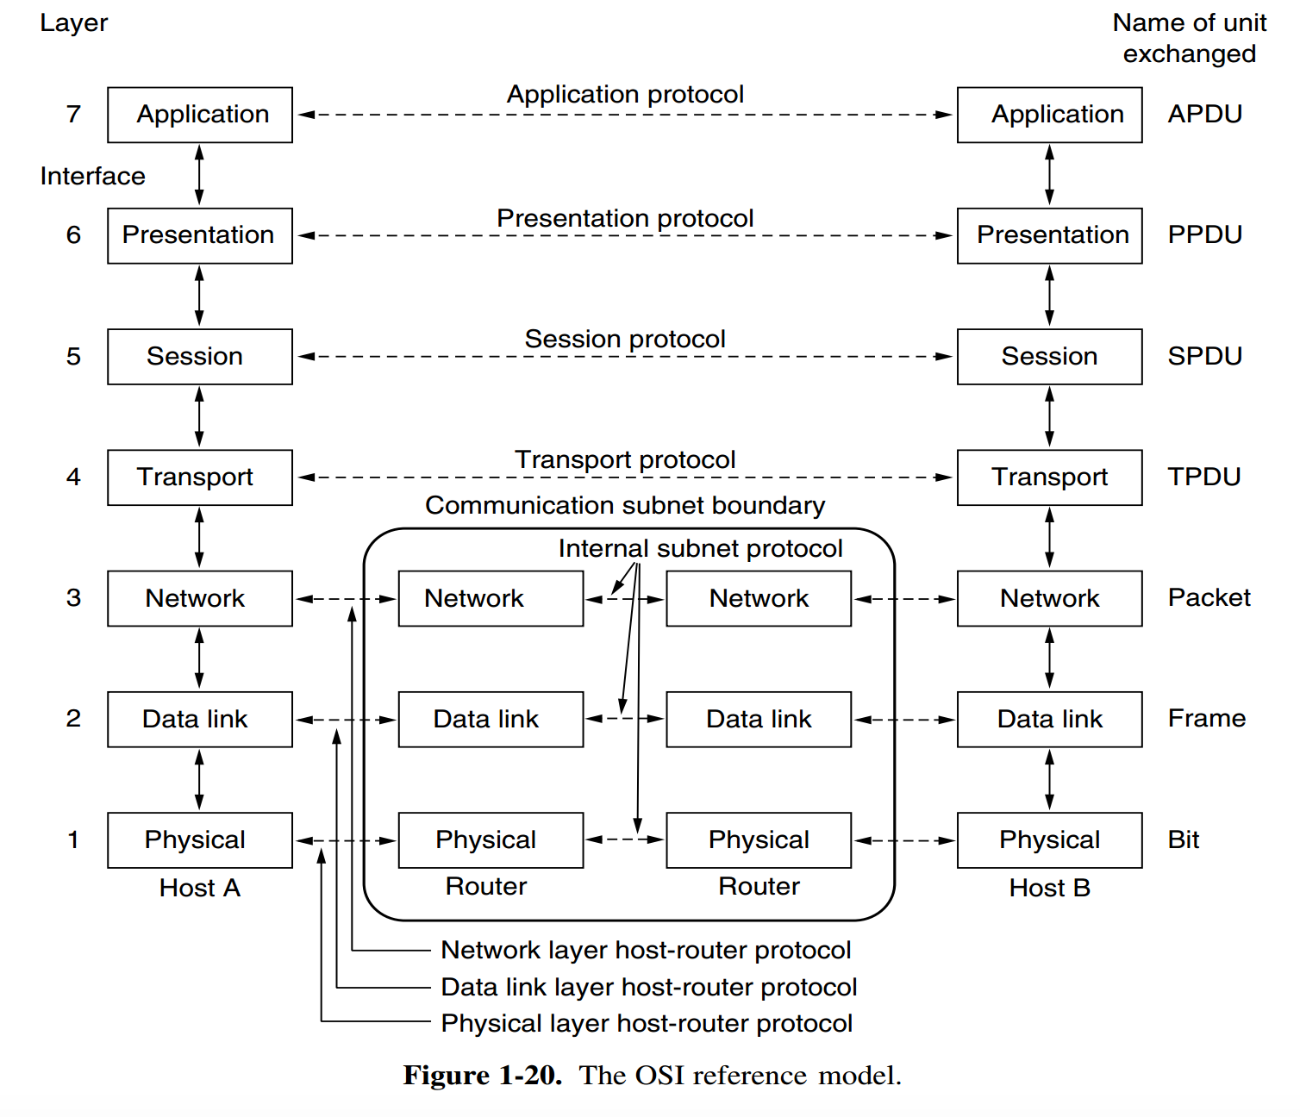
OSI Reference Model
All People Seem To Need Data Processing

Slide 3
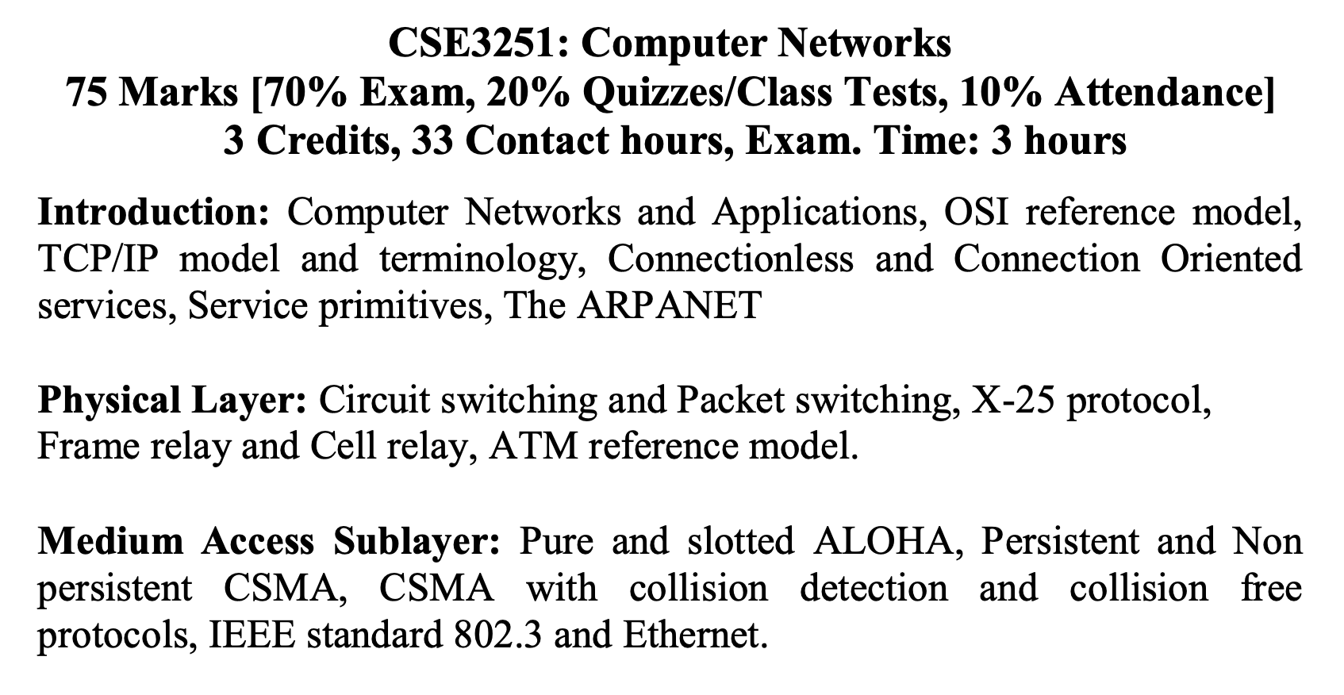
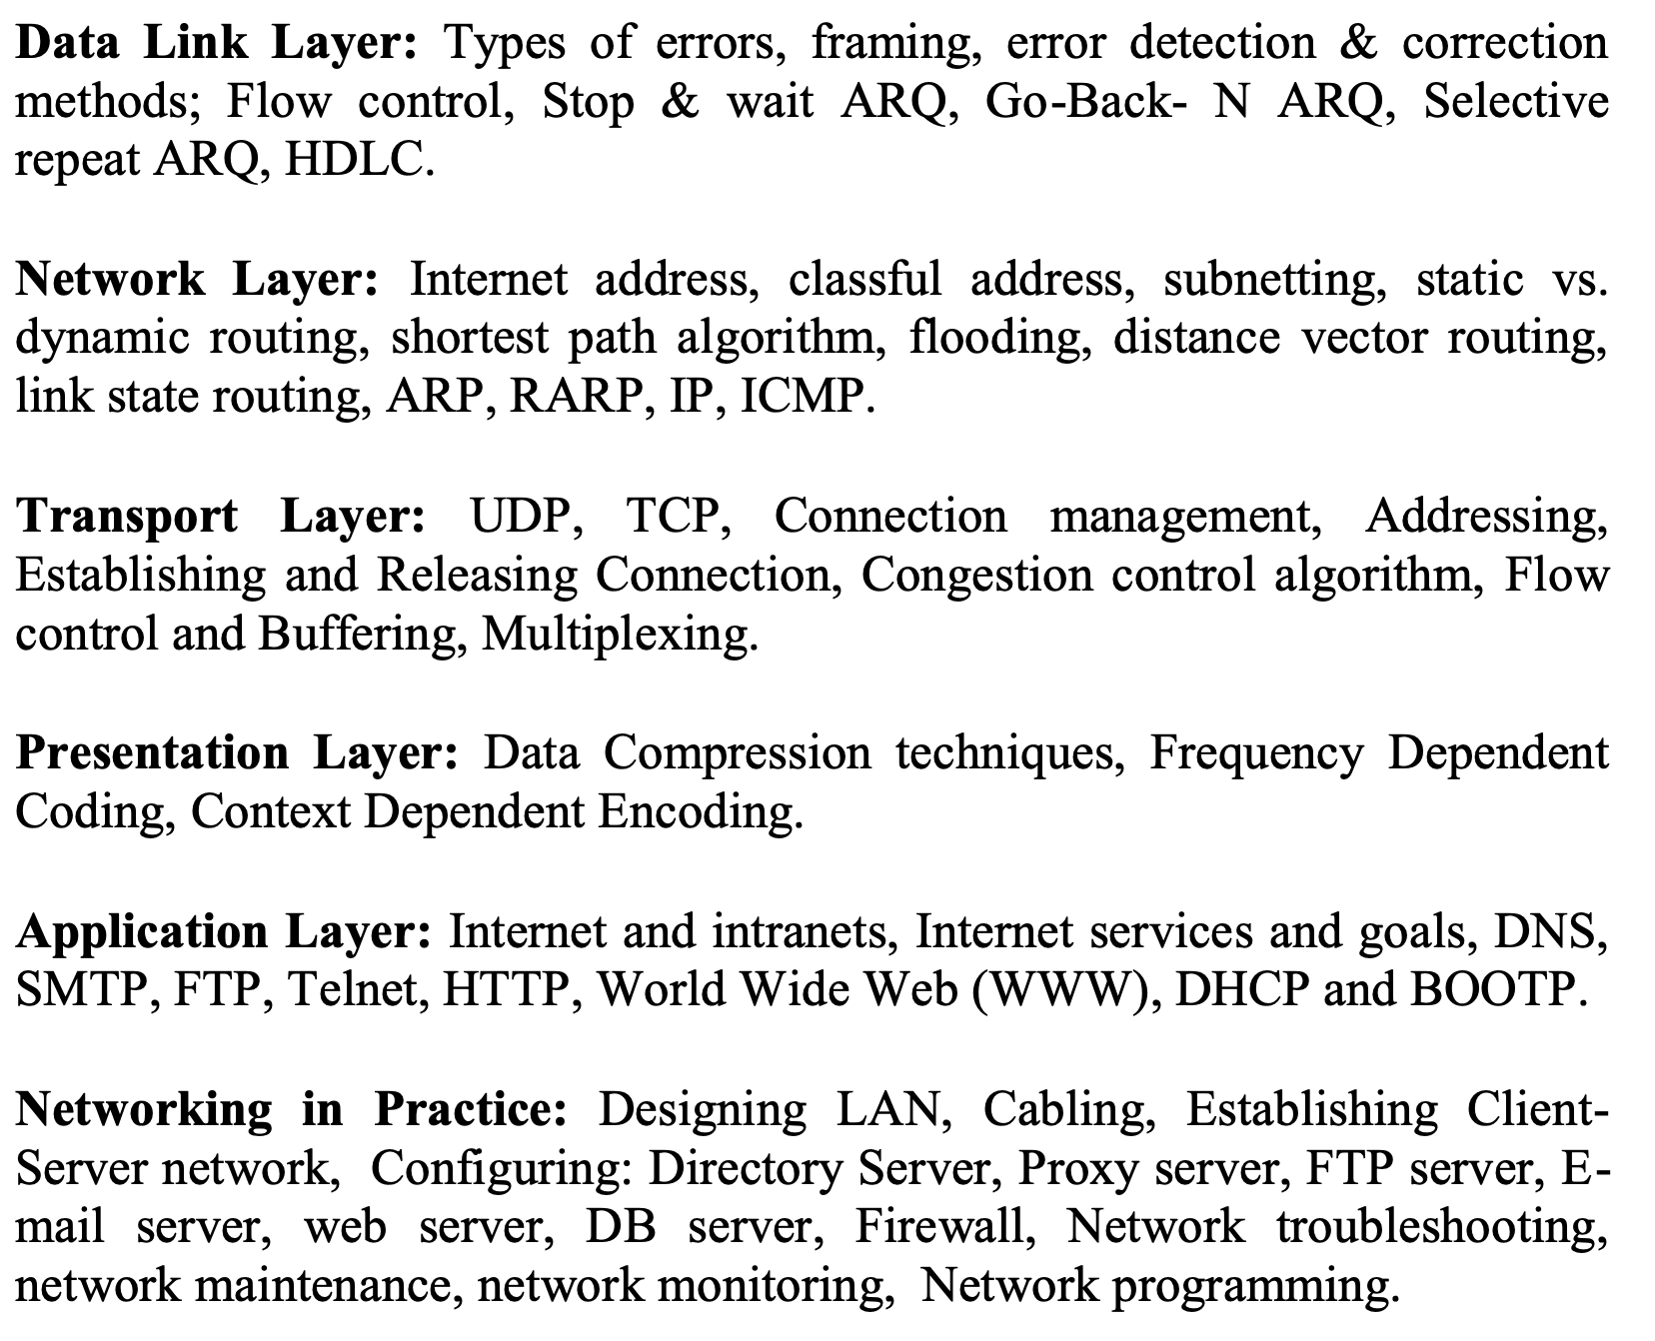

Slide 4
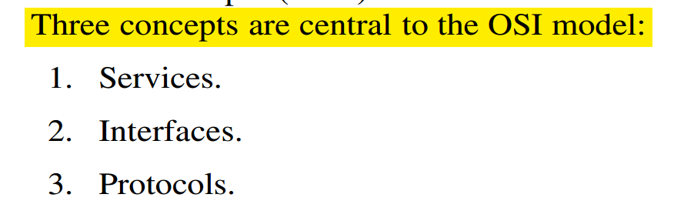
OSI Model
The service definition tells what the layer does, not how entities above it access it or how the layer works.
Layer’s interface tells the processes above it how to access it. It specifies what the parameters are and what results to expect.
Finally, the peer protocols used in a layer are the layer’s own business. It can use any protocols it wants to, as long as it gets the job done (i.e., provides the offered services). It can also change them at will without affecting software in higher layers.

Slide 5
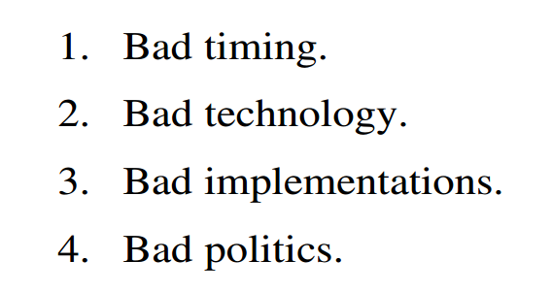
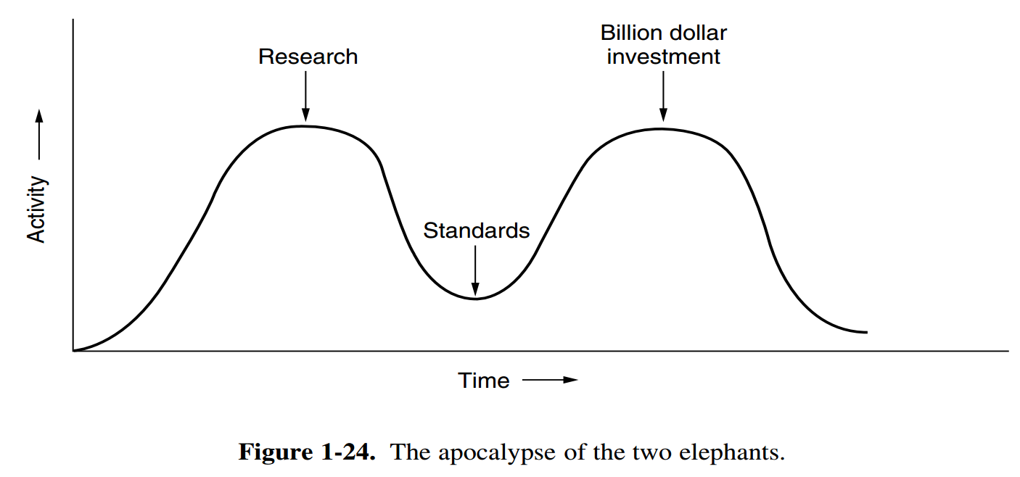
Why OSI Model Failed…
রহস্যউন্মোচন
David Clark of M.I.T. has a theory of standards that he calls the apocalypse of the two elephants

Slide 6
A Critique of the OSI Model
Bad Technology
The choice of seven layers was more political than technical, and two of the layers (session and presentation) are nearly empty,
Whereas two other ones (data link and network) are overfull
Bad Implementations
Given the enormous complexity of the model and the protocols, it will come as no surprise that the initial implementations were huge, unwieldy, and slow.
Bad Politics
…be the creature European telecommunication ministries, the European Community, and later the U.S. Government

Slide 7
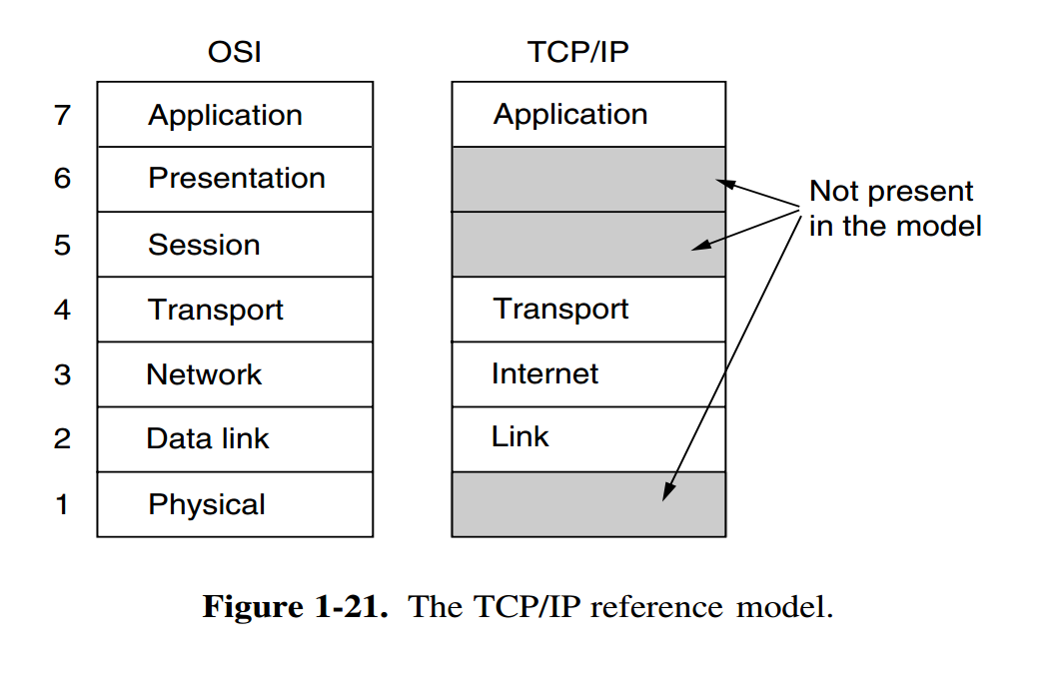
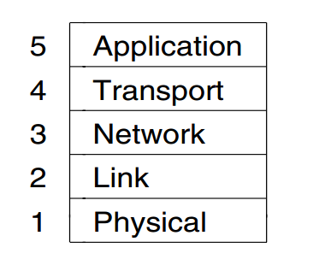
TCP/IP Reference Model

Slide 8
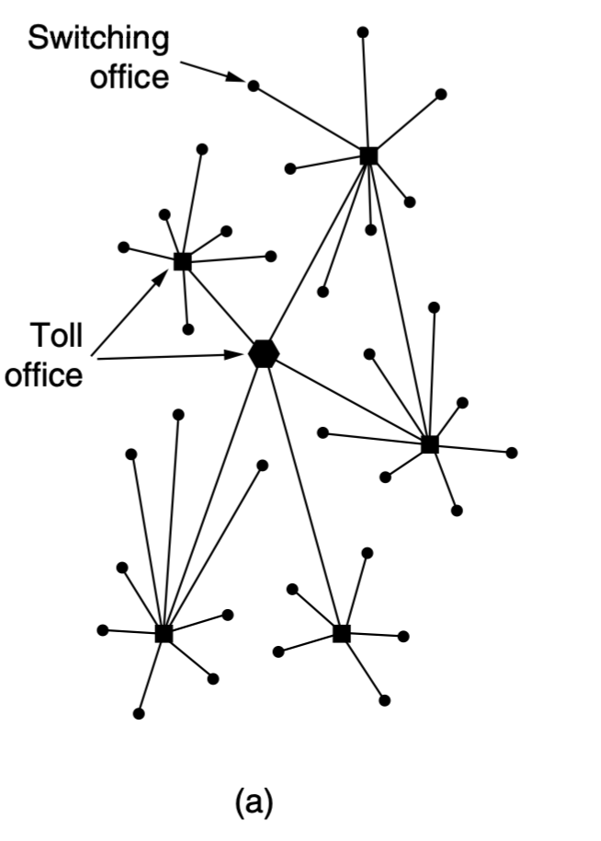
The ARPANET
The story begins in the late 1950s.
… Cold War, the U.S. DoD wanted
a command-and-control network that could survive a nuclear war.
Around 1960, the DoD awarded a contract to the RAND Corporation to find a solution.

Slide 9
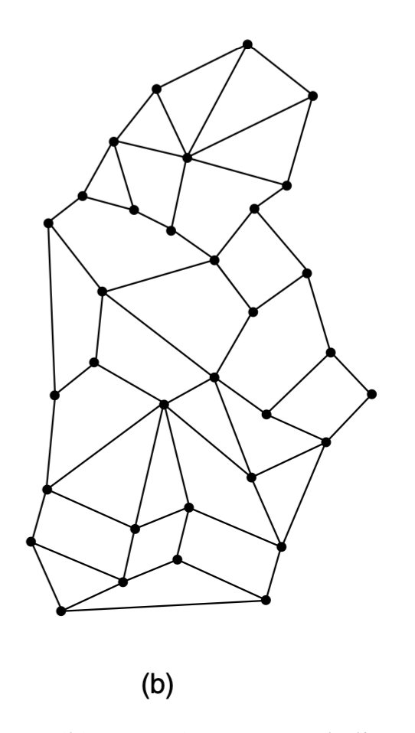
The ARPANET
Paul Baran proposed distributed switching system (Baran, 1964).
Officials at the Pentagon liked the concept and asked AT&T.
AT&T dismissed Baran’s ideas out ofhand

Slide 10
The ARPANET
US President …. to create a single defense research organization, ARPA, the Advanced Research Projects Agency.
ARPA had no scientists or laboratories; in fact, it had nothing more than an office and a small (by Pentagon standards) budget.
It did its work by issuing grants and contracts to universities and companies whose ideas looked promising to it.

Slide 11
The ARPANET
1967, Larry Roberts, a program manager at ARPA
ACM SIGOPS Symposium on Operating System Principles held in Gatlinburg, Tennessee in late 1967 (Roberts, 1967)…
… fully implemented under the direction of Donald Davies at the National Physical Laboratory (NPL) in England.
it cited Baran’s work
Roberts came away from Gatlinburg determined to build what later became known as the ARPANET

Slide 12
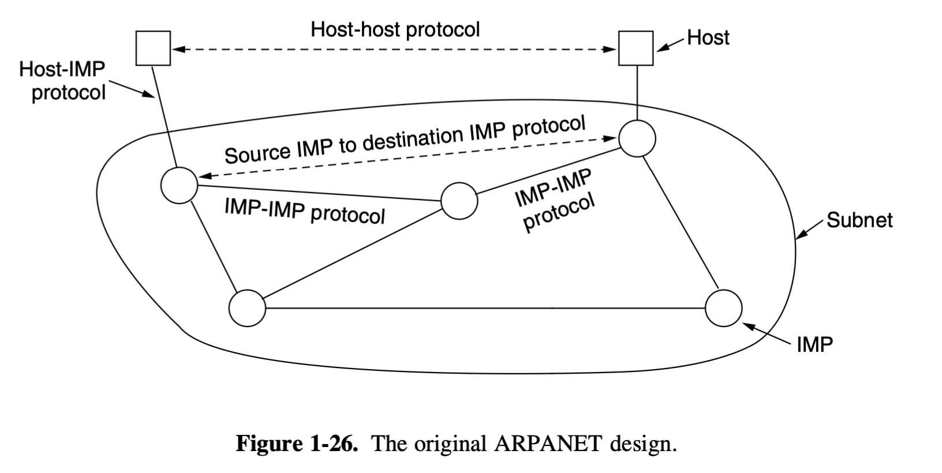
The ARPANET
The subnet would consist of minicomputers called IMPs (Interface Message Processors)
Connected by 56-kbps transmission lines.
For high reliability, each IMP would be connected to at least two other IMPs.
The subnet was to be a datagram subnet, so if some lines and IMPs were destroyed, messages could be automatically rerouted along alternative paths.

Slide 13
The ARPANET
Each node of the network was to consist of an IMP and a host, in the same room, connected by a short wire.
A host could send messages of up to 8063 bits to its IMP, which would then break these up into packets of at most 1008 bits and forward them independently toward the destination.
Each packet was received in its entirety before being forwarded, so the subnet was the first electronic store- and-forward packet-switching network.
The software was split into two parts: subnet and host.
The subnet software consisted of the IMP end of the host-IMP connection, the IMP-IMP protocol, and
a source IMP to destination IMP protocol designed to improve reliability.

